Slide 1
MetaHeuristic framework Using a Genetic Algorithm
By: George Le

Slide 2
Genetic algorithm
Designed a framework, utilizing an automated maze solver, an algorithm scorer, and a genetic algorithm, as a meta heuristic for search algorithms applied to a 2D maze.
Individuals were Boolean arrays.

Slide 3
Search algorithms
A*
BFS
Best first
Uniform cost

Slide 4
Fitness Function
Scores were assigned to the search algorithms, the scores being heuristic values for the algorithms.
Scores were calculated based on the following metrics:
Optimality (Finds the true shortest path)
Completeness (Finds the goal)
Efficiency (Amount of nodes searched)
Time (Amount of time in milliseconds taken to solve the problem)
We selected the fittest half of the current generation to live on to the next generation and select two individuals from that half to reproduce.

Slide 5
Genetic Operators
Crossover and Mutation on new “children” individuals
We used two point crossover and bit string mutation.
Future upgrades can be made (uniform crossover and gaussian mutation for int or float values)

Slide 6
Results of GA
The individual(s) with the highest average scores for their combination of search algorithms will be considered the fittest individual.
Individual is an array of Boolean values and can be parsed to determine which algorithms contributed to the highest average.

Slide 7
Expected data
Stores the filename of the problem
Stores the “best” solution(s) of the problem
Stores the name of the “best” algorithms

Slide 8
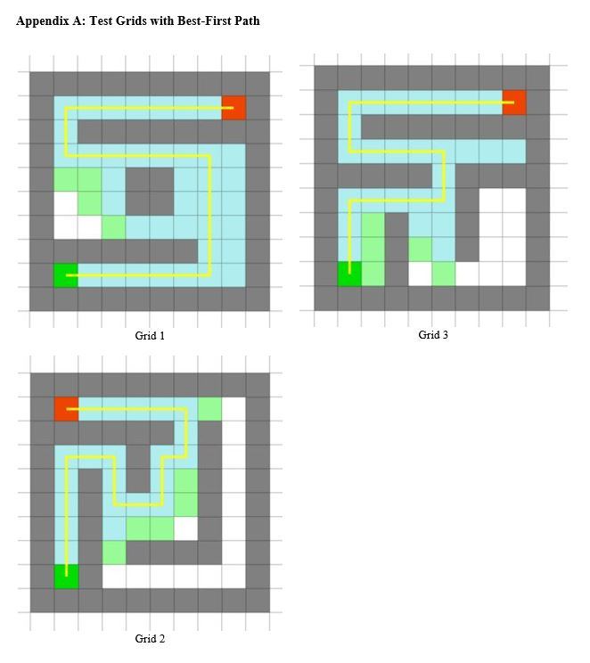

Slide 9
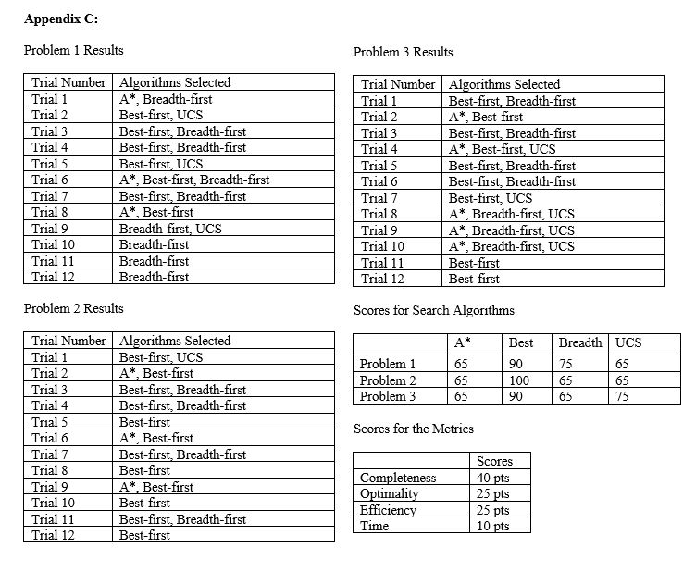
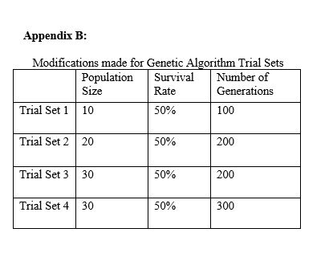

Slide 10
FUTURE WORK
Inclusion of additional search algorithms (IDA, other hill climbing, greedy versions, genetic algorithm!, etc.)
Additional generations and population size can improve the GA. Repetition of the GA to generate expected data can ensure precision.
Can make GA a template to allow for any type of problem and its solver to be used with the GA class.
Generate expected data to train other AI systems such as artificial neural networks.
Given a different test file, can be compare to existing expected data to see if the same search problem has been searched before and can just produce an answer instead of wasting the time to generate a solution.
Can be extended to have 2D grids stacked on top of each other for verticality to allow for 3D search problems.

